Slide 1
Collaborative Modelling Application
Team 3 Infrastructure and Incremental Deliverable 1

Slide 2
Outline
Who we are
What is the project
Teams
Design
Implementation
Testing
Triage
Summary
Questions

Slide 3
Who we are
Project management
Royce M.
Build and Integration
Shane W.
Risk Officer
James M.
Design
Corey H., Darvin Z., Mitchell L.
Implementation
Michael R., Michael K., Matt H, Connor N-G, Shane W.
Testing
Mahmoud M., Bengin L., Angela S., Jordan W.
Triage
James M., Bengin L.

Slide 4

The Project QM-Lab
Modeling
Means of expressing relationships between various factors
Qualitative
Modeling with respect to characteristics rather than quantity
Collaborative
Joint efforts of multiple people to create and understand the model
Motivation
Modernize the modeling process (used strings and pins on board)
No tools out there offer collaboration aspect
Notes:
Improvise and stop reading the slide. look at the peeps more

Slide 5
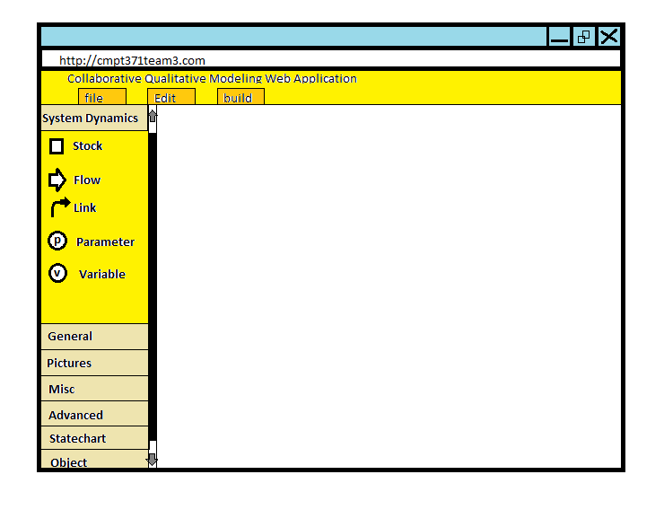
Design
Currently
Preliminary storyboards
Broad system diagrams
Google Realtime API model
Architectures
Last-write-wins consistency model
Future
Lower level design within different systems
Consider the pros and cons of our researched architectures
Initial storyboard mockup

Slide 6
Implementation
Web App
HTML5
CSS3
JavaScript
Framework
Django
Python
Collaborative Technologies
Google’s Realtime API
Database
PostgreSQL
Notes:
Talking points: For the front-end, we’re probably going to make extensive use of HTML’s Canvas functionality. The built in Drag and Drop features will also probably be used extensively.
For the back-end, we’re making use of Django’s user-friendly framework to ensure everything is organized and relatively easy for the testing team.
We’re still looking into the exact specifics of the Google Realtime API. However, from what we’ve been able to test so far, it seems like it will work perfectly for our needs.
As far as the database is concerned, it will probably only be needed for user logins and permissions. Google’s Realtime API seems to handle everything else.
For future development, more spike tests to ensure all technologies talk well to each other. What few spike tests we’ve created so far seem to indicate there won’t be any issues.
Probably should also mention that the Google Realtime API also seems to handle saving for us. I’m able to bring up exact edits I made several hours earlier without attempting to save.

Slide 7
Testing
Why test?
Web app
Collaborative software
What to test?
Functionality
Useability
Interface
Compatibility
Performance
Security (later on in the game)
Components
Web Application
Database
Server
Notes:
the system has many components that need to be tested individually also they will need to be tested in an aggregate fashion
Web app == many dynamic variables (browsers, platforms, users )
collaborative == many users at one time, therefore the system will need to handle multiple/concurrent inputs/transactions
we will talk about each of those points next.

Slide 8
Testing
Testing aspects
Functionality
Negative testing
Data integrity
Dead pages or redirections
Cookies and localstorage
Useability
Navigation
Content checking
Interface
Flow of data between the different system layers
Notes:
talk about smoke tests done after build by running selenium webdriver to check basic functionality

Slide 9
Testing
Testing aspects
Compatibility
Cross browser
Print options
Performance
Stress testing
Load testing
Soak testing
Spike testing
testing under different connection speeds
Security (later on in the game)
SQL Injections
Sensitive Data exposure

Slide 10
Testing
Tools, Frameworks and APIs
Django unittest, webtest
Python unittest, coverage, mock
factory_boy data fixtures
Selenium or Sahi webdrivers and automators
Python scripts to test database
Stress testing using Selenium testing grid
HTML and CSS validators
Redmine for issue tracking
Notes:
first three represent test harness where you have tests and then controlled set of data fixtures
test automation is selenium
stress testing selenium using rather than having many ppl trying to break the system
validators are not testing but it is something that will be used to make sure web pages are represented properly
redmine with all the team members on it to track bugs issue and features

Slide 11
Build and Continuous Integration
Tools
Jenkins
easy install/config, rich plugins available, extensible
Purpose
People are forgetful, they will forget to run tests. A test suite is only useful if we run it.
Eliminate this risk by automating the process.
Notes:
We will be using Jenkins to handle our build/CI needs.

Slide 12
Triage
What is triaging?
Focusing time and resources on high priority tasks (relatively small investments for high returns).
Spending less time on OR getting rid of completely low priority ones (large investments for little returns).
It takes a fairly low investment to do a decent job (Pareto’s 80/20 principle), but an unproportionately large amount of effort to do a PERFECT job.
Notes:
http://www.stevepavlina.com/blog/2006/05/10-tips-for-college-students/
CTRL-F “triage”

Slide 13
Summary
What we hope to make
Revolutionize the scope of qualitative modeling
Collaborative qualitative modeling web app (QM-Lab)
Learning outcomes
Gain further familiarity with software engineering processes
Acquire real world experiences dealing with stakeholders and teammates
Hone our web application development skills and standards

Slide 14
Thanks for listening!
Questions?

